Slide 1
D.C. Generators

Slide 2
D.C. Generators
Generator Principal
Simple Loop Generator
Practical Generator
Yoke
Pole Cores and Pole Shoes
Pole Coils
Armature Core
Armature Windings
Commutator
Brushes and Bearings
Armature Windings
Contd….

Slide 3
D.C. Generators
Pole-pitch
Conductor
Coil and Winding Element
Coil-span or Coil-pitch (Y_{s})
Pitch of a Winding (Y)
Back Pitch (Y_{B})
Front Pitch (Y_{F})
Resultant Pitch (Y_{R})
Commutator Pitch (Y_{G})
Single-layer Winding
Two-layer Winding
Contd….

Slide 4
D.C. Generators
Lap and Wave Winding
Simplex-lap Winding
Simplex Wave Winding
Uses of Lap and Wave Windings
Types of Generators
Brush Contact Drop
Generated E.M.F. or E.M.F. Equation of a Generator
Contd….

Slide 5
D.C. Generators
Iron Loss in Armature
Total loss in a D.C. Generator
Stray Losses
Constant or Standing Losses
Power Stages
Condition for Maximum Efficiency

Slide 6
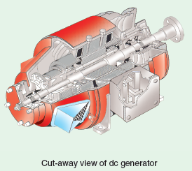
Generator Principle
An electrical generator is a machine which converts mechanical energy (or power) into electrical energy (or power).
Two basic essential parts of an electrical generator are (i) a magnetic field and (ii) a conductor or conductors which can so move as to cut the flux.

Slide 7
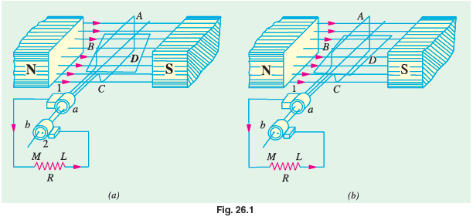
Simple Loop Generator
Construction
Asingle-turn rectangular copper coil ABCD rotating about its own axis in a magnetic field provided by either permanent magnet is or electromagnets is shown in Fig. below:.
Contd….

Slide 8
Simple Loop Generator
Construction
The two ends of the coil are joined to two slip-rings ‘a’ and ‘b’ which are insulated from each other and from the central shaft. Two collecting brushes (of carbon or copper) press against the slip-rings.
The rotating coil may be called ‘armature’ and the magnets as ‘field magnets’.
Contd….

Slide 9
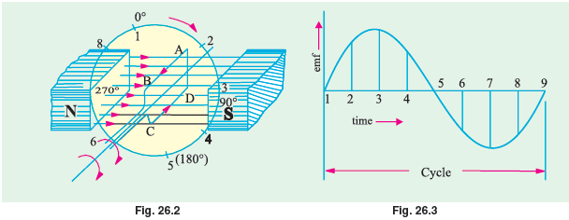
Simple Loop Generator
Working
Imagine the coil to be rotating in clock-wise direction. As the coil assumes successive positions in the field, the flux linked with it changes. Hence, an e.m.f. is induced in it which is proportional to the rate of change of flux linkages (e = NdΦdt). When the plane of the coil is at right angles to lines of flux i.e. when it is in position, 1, then flux linked with the coil is maximum but rate of change of flux linkages is minimum.
Contd….

Slide 10
Simple Loop Generator
Working
As the coil continues rotating further, the rate of change of flux linkages (and hence induced e.m.f. in it) increases, till position 3 is reached where θ = 90º. Here, the coil plane is horizontal i.e. parallel to the lines of flux. As seen, the flux linked with the coil is minimum but rate of change of flux linkages is maximum. Hence, maximum e.m.f. is induced in the coil when in this position.
Contd….

Slide 11
Practical Generator
The simple loop generator has been considered in detail merely to bring out the basic principle underlying construction and working of an actual generator illustrated in Fig. which consists of the following essential parts :
1. Magnetic Frame or Yoke 2. Pole-Cores and Pole-Shoes
3. Pole Coils or Field Coils 4. Armature Core
5. Armature Windings or Conductors 6. Commutator
7. Brushes and Bearings
Contd….

Slide 12
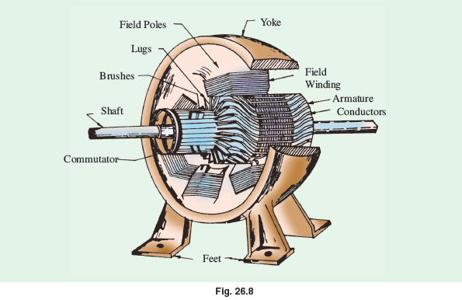
Practical Generator

Slide 13
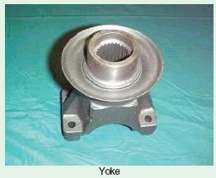
Yoke
The outer frame or yoke serves double purpose :
It provides mechanical support for the poles and acts as a protecting cover for the whole machine and
It carries the magnetic flux produced by the poles.

Slide 14
Pole Cores and Pole Shoes
The field magnets consist of pole cores and pole shoes. The pole shoes serve two purposes
They spread out the flux in the air gap and also, being of larger cross-section, reduce the reluctance of the magnetic path
They support the exciting coils (or field coils).
Contd….

Slide 15
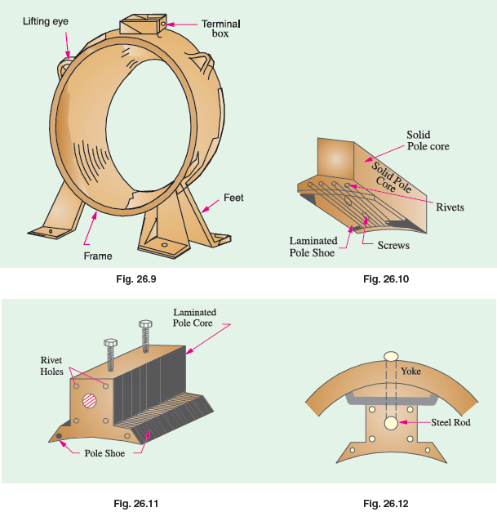
Pole Cores and Pole Shoes

Slide 16
Pole Coils
The field coils or pole coils, which consist of copper wire or strip, are former-wound for the correct dimension. Then, the former is removed and wound coil is put into place over the core as shown in Fig.
When current is passed through these coils, they electromagnetise the poles which produce the necessary flux that is cut by revolving armature conductors.
Contd….

Slide 17
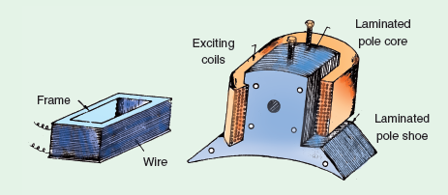
Pole Coils

Slide 18
Armature Core
It houses the armature conductors or coils and causes them to rotate and hence cut the magnetic flux of the field magnets. In addition to this, its most important function is to provide a path of very low reluctance to the flux through the armature from a N- pole to a S-pole.
It is cylindrical or drum-shaped and is built up of usually circular sheet steel discs or laminations approximately 0.5 mm thick (Fig. ). It is keyed to the shaft.
Up to armature diameters of about one metre, the circular stampings are cut out in one piece as shown in Fig. But above this size, these circles, especially of such thin sections, are difficult to handle because they tend to distort and become wavy when assembled together.
Contd….

Slide 19
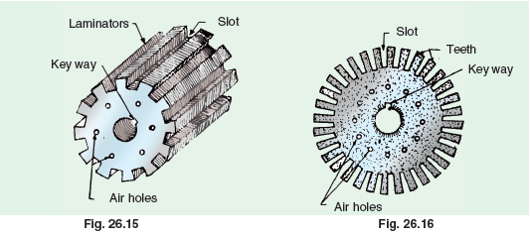
Armature Core

Slide 20
Armature Windings
The armature windings are usually former-wound.
These are first wound in the form of flat rectangular coils and are then pulled into their proper shape in a coil puller.
Various conductors of the coils are insulated from each other.
The conductors are placed in the armature slots which are lined with tough insulating material.
This slot insulation is folded over above the armature conductors placed in the slot and is secured in place by special hard wooden or fibre wedges.

Slide 21
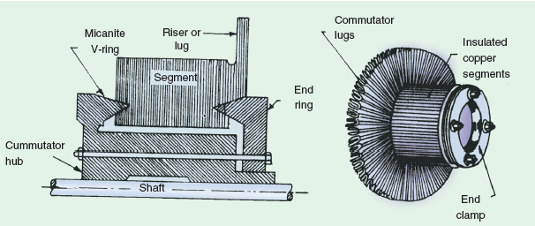
Commutator
The function of the commutator is to facilitate collection of current from the armature conductors.
A sectional view of commutator is shown in Fig. whose general appearance when completed is shown in Fig.

Slide 22
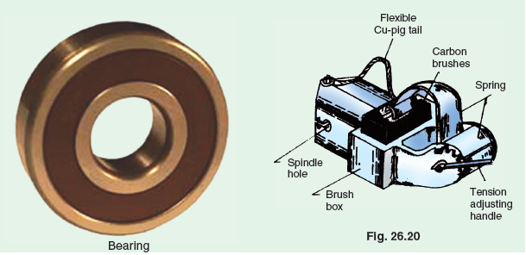
Brushes and Bearings
The brushes whose function is to collect current from commutator, are usually made of carbon or graphite and are in the shape of a rectangular block. These brushes are housed in brush-holders usually of the box-type variety. As shown in Fig. , the brush-holder is mounted on a spindle and the brushes can slide in the rectangular box open at both ends.

Slide 23
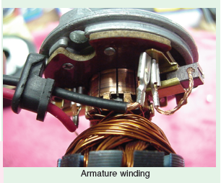
Armature Windings
Now, we will discuss the winding of an actual armature. But before doing this, the meaning of the following terms used in connection with armature winding should be clearly kept in mind.

Slide 24
Pole – Pitch
It may be variously defined as :
The periphery of the armature divided by the number of poles of the generator i.e. the distance between two adjacent poles.
It is equal to the number of armature conductors (or armature slots) per pole. If there are 48 conductors and 4 poles, the pole pitch is 48/4 = 12.

Slide 25
Conductor
The length of a wire lying in the magnetic field and in which an e.m.f. is induced, is called a conductor (or inductor) as, for example, length AB or CD in Fig.

Slide 26
Coil and Winding Element
With reference to Fig., the two conductors AB and CD along with their end connections constitute one coil of the armature winding.
The coil may be single-turn coil (Fig.) or multi-turn coil (Fig. ). A single-turn coil will have two conductors. But a multi- turn coil may have many conductors per coil side. In Fig., for example, each coil side has 3 conductors.
The group of wires or conductors constituting a coil side of a multi-turn coil is wrapped with a tape as a unit (Fig.) and is placed in the armature slot.
Contd….

Slide 27
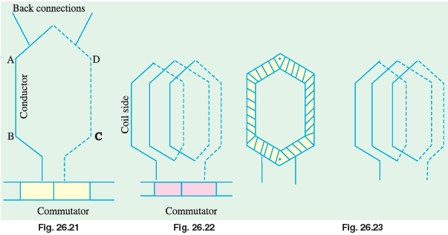
Coil and Winding Element

Slide 28
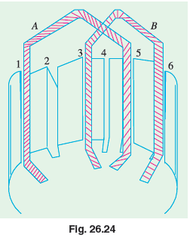
Coil – Span or Coil – Pitch (Y_{S})
It is the distance, measured in terms of armature slots (or armature conductors) between two sides of a coil. It is, in fact, the periphery of the armature spanned by the two sides of the coil.
If the pole span or coil pitch is equal to the pole pitch (as in the case of coil A in Fig. where pole-pitch of 4 has been assumed), then winding is called full-pitched.

Slide 29
Pitch of a Winding (Y)
In general, it may be defined as the distance round the armature between two successive conductors which are directly connected together. Or, it is the distance between the beginnings of two consecutive turns.
Y = Y_{B} − Y_{F} ........for lap winding
= Y_{B} + Y_{F} ........for wave winding

Slide 30
Back Pitch (Y_{B})
The distance, measured in terms of the armature conductors, which a coil advances on the back of the armature is called back pitch and is denoted by Y_{B}.
As seen from Fig., element 1 is connected on the back of the armature to element 8. Hence, Y_{B} = (8 − 1) = 7.

Slide 31
Front Pitch (Y_{F})
The number of armature conductors or elements spanned by a coil on the front (or commutator end of an armature) is called the front pitch and is designated by Y_{F}. Again in Fig., element 8 is connected to element 3 on the front of the armature, the connections being made at the commutator segment. Hence, Y_{F} = 8 − 3 = 5.
Alternatively, the front pitch may be defined as the distance (in terms of armature conductors) between the second conductor of one coil and the first conductor of the next coil which are connected together at the front i.e. commutator end of the armature. Both front and back pitches for lap and wave-winding are shown in Fig.
Contd….

Slide 32
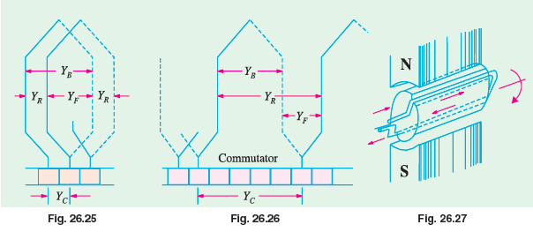
Front Pitch (Y_{F})

Slide 33
Resultant Pitch (Y_{R})
It is the distance between the beginning of one coil and the beginning of the next coil to which it is connected (Fig.).
As a matter of precaution, it should be kept in mind that all these pitches, though normally stated in terms of armature conductors, are also sometimes given in terms of armature slots or commutator bars because commutator is, after all, an image of the winding.

Slide 34
Single – Layer Winding
It is that winding in which one conductor or one coil side is placed in each armature slot as shown in Fig. Such a winding is not much used.

Slide 35
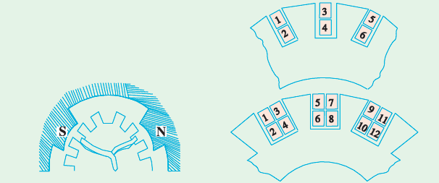
Two – Layer Winding
In this type of winding, there are two conductors or coil sides per slot arranged in two layers.
The transfer of the coil from one slot to another is usually made in a radial plane by means of a peculiar bend or twist at the back end as shown in Fig.
Sometimes 4 or 6 or 8 coil sides are used in each slot in several layers because it is not practicable to have too many slots (Fig.).

Slide 36
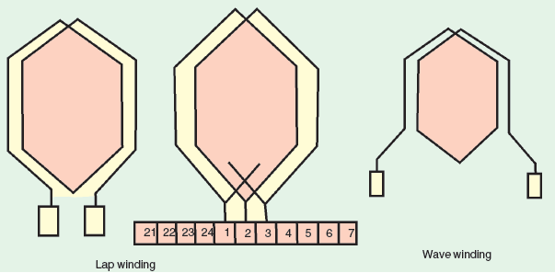
Lap and Wave Windings
Two types of windings mostly employed for drum-type armatures are known as Lap Winding and Wave Winding.
The difference between the two is merely due to the different arrangement of the end connections at the front or commutator end of armature.
Each winding can be arranged progressively or retrogressively and connected in simplex, duplex and triplex.

Slide 37
Simplex Lap – Winding
It is shown in Fig. which employs single-turn coils.
In lap winding, the finishing end of one coil is connected to a commutator segment and to the starting end of the adjacent coil situated under the same pole and so on, till and the coils have been connected.
This type of winding derives its name from the fact it doubles or laps back with its succeeding coils.
Contd….

Slide 38
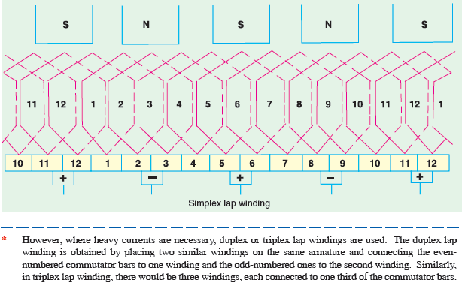
Simplex Lap – Winding

Slide 39
Simplex Wave Winding
It is clear that in lap winding, a conductor (or coil side) under one pole is connected at the back to a conductor which occupies an almost corresponding position under the next pole of opposite polarity (as conductors 3 and 12).
Conductor No. 12 is then connected to conductor No. 5 under the original pole but which is a little removed from the initial conductor No. 3.
If, instead of returning to the same N-pole, the conductor No. 12 were taken forward to the next N-pole, it would make no difference so far as the direction and magnitude of the e.m.f. induced in the circuit are concerned.

Slide 40
Uses of Lap and Wave Windings
The advantage of the wave winding is that, for a given number of poles and armature conductors, it gives more e.m.f. than the lap winding. Conversely, for the same e.m.f., lap winding would require large number of conductors which will result in higher winding cost and less efficient utilization of space in the armature slots.
Another advantage is that in wave winding, equalizing connections are not necessary whereas in a lap winding they definitely are. It is so because each of the two paths contains conductors lying under all the poles whereas in lap-wound armatures, each of the P parallel paths contains conductors which lie under one pair of poles.

Slide 41
Types of Generators
Generators are usually classified according to the way in which their fields are excited. Generators may be divided into
Separately-excited generators are those whose field magnets are energised from an independent external source of d.c. current. It is shown diagramatically in Fig.
Self-excited generators are those whose field magnets are energised by the current produced by the generators themselves. Due to residual magnetism, there is always present some flux in the poles.

Slide 42
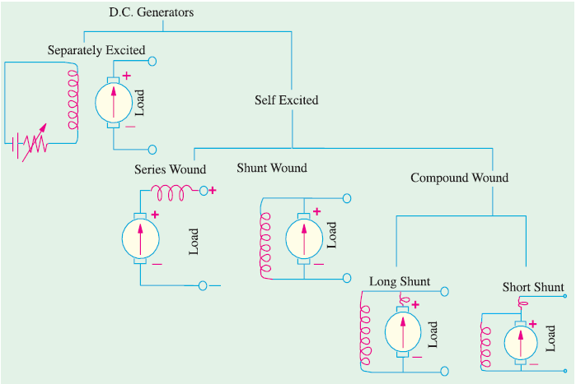
Types of Generators

Slide 43
Brush Contact Drop
It is the voltage drop over the brush contact resistance when current passes from commutator segments to brushes and finally to the external load. Its value depends on the amount of current and the value of contact resistance. This drop is usually small and includes brushes of both polarities. However, in practice, the brush contact drop is assumed to have following constant values for all loads.
0.5 V for metal-graphite brushes.
2.0 V for carbon brushes.

Slide 44
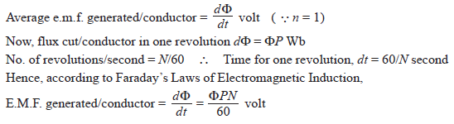
Generated E.M.F. or E.M.F. Equation of a Generator
Let Φ = flux/pole in weber
Z = total number of armature conductors
= No. of slots x No. of conductors/slot
P = No. of generator poles
A = No. of parallel paths in armature
N = armature rotation in revolutions per minute (r.p.m.)
E = e.m.f. induced in any parallel path in armature
Generated e.m.f. E_{g} = e.m.f. generated in any one of the parallel paths i.e. E.

Slide 45
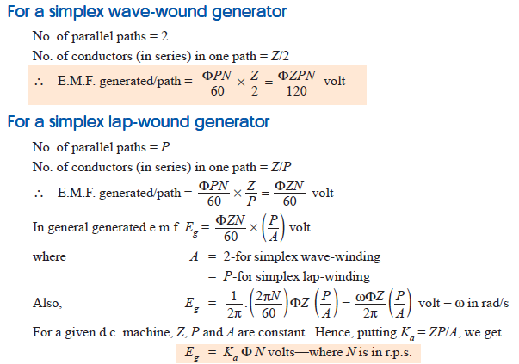
Generated E.M.F. or E.M.F. Equation of a Generator

Slide 46
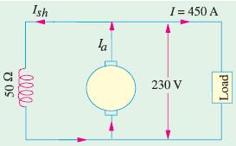
Example-1
A shunt generator delivers 450 A at 230 V and the resistance of the shunt field and armature are 50 Ω and 0.03 Ω respectively. Calculate the generated e.m.f.
Solution:
Current through shunt field winding is
Ish = 230/50 = 4.6 A
Load current I = 450 A
∴ Armature current Ia= I + Ish
= 450 + 4.6 = 454.6 A
Now Eg = terminal voltage + armature drop = V + IaRa
∴ e.m.f. generated in the armature
Eg = 230 + 13.6 = 243.6 V

Slide 47
Iron Loss in Armature
Due to the rotation of the iron core of the armature in the magnetic flux of the field poles, there are some losses taking place continuously in the core and are known as Iron Losses or Core Losses. Iron losses consist of
Hysteresis loss
Eddy Current loss

Slide 48
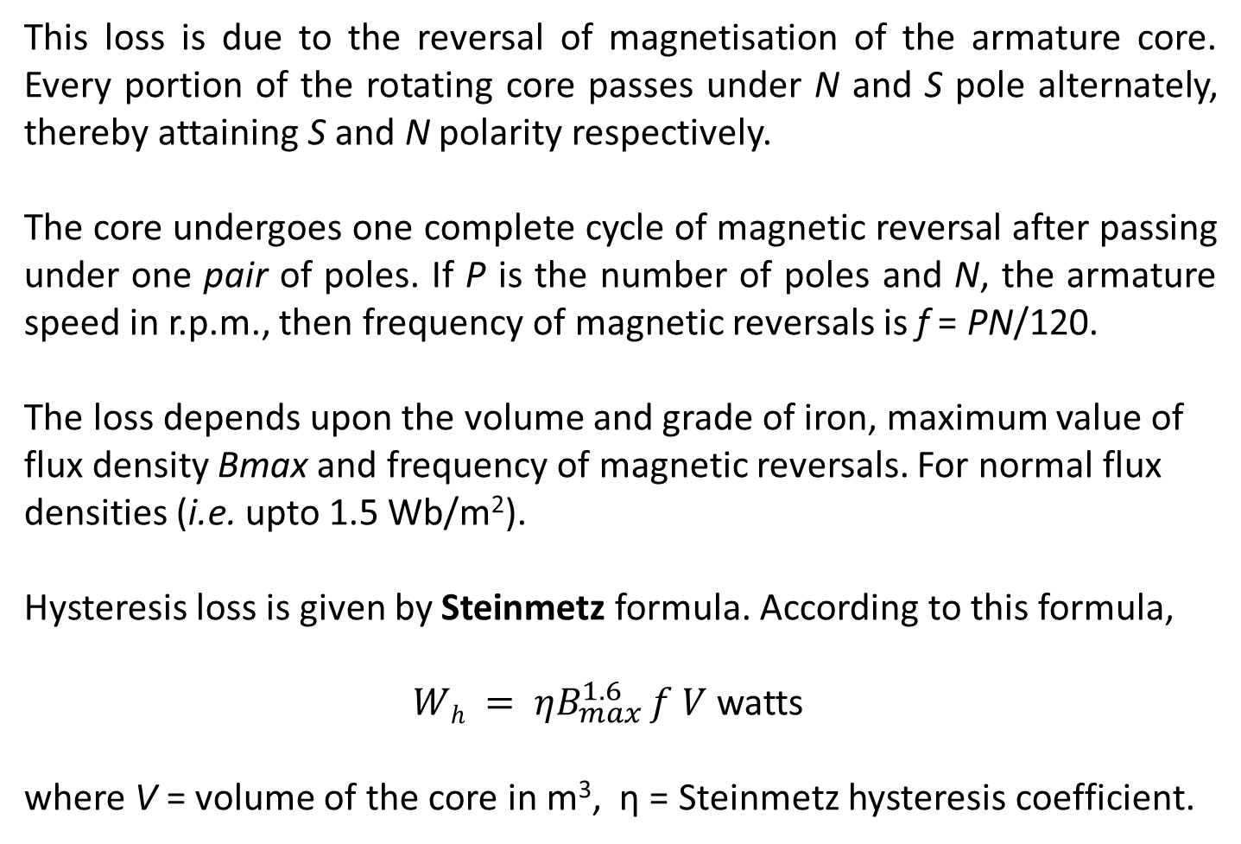
Hysteresis Loss
This loss is due to the reversal of magnetisation of the armature core. Every portion of the rotating core passes under N and S pole alternately, thereby attaining S and N polarity respectively.
The core undergoes one complete cycle of magnetic reversal after passing under one pair of poles. If P is the number of poles and N, the armature speed in r.p.m., then frequency of magnetic reversals is f = PN/120.
The loss depends upon the volume and grade of iron, maximum value of flux density Bmax and frequency of magnetic reversals. For normal flux densities (i.e. upto 1.5 Wb/m²).
Hysteresis loss is given by Steinmetz formula. According to this formula,
$Wh = ηB_{max}^{1.6}⁡f V$ watts
where V = volume of the core in m³, η = Steinmetz hysteresis coefficient.

Slide 49
Hysteresis Loss
In one revolution of armature with two number of pole there will be one cycle of sinusoidal voltage. Similarly with four pole there will be two cycle in one revolution and so on.
Therefore we can generalize that,
Cycles per revolution = P/2 Where P = no. of pole
If n = revolution per second
No. of Cycles per second = Pn/2
If N = revolution per minute
No. of Cycle per Second = f = PN/120

Slide 50
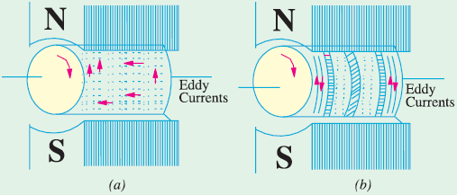
Eddy Current Loss
When the armature core rotates, it also cuts the magnetic flux. Hence, an e.m.f. is induced in the body of the core according to the laws of electromagnetic induction.
This e.m.f. though small, sets up large current in the body of the core due to its small resistance.
This current is known as eddy current.
The power loss due to the flow of this current is known as eddy current loss.
This loss would be considerable if solid iron core were used. In order to reduce this loss and the consequent heating of the core to a small value, the core is built up of thin laminations

Slide 51
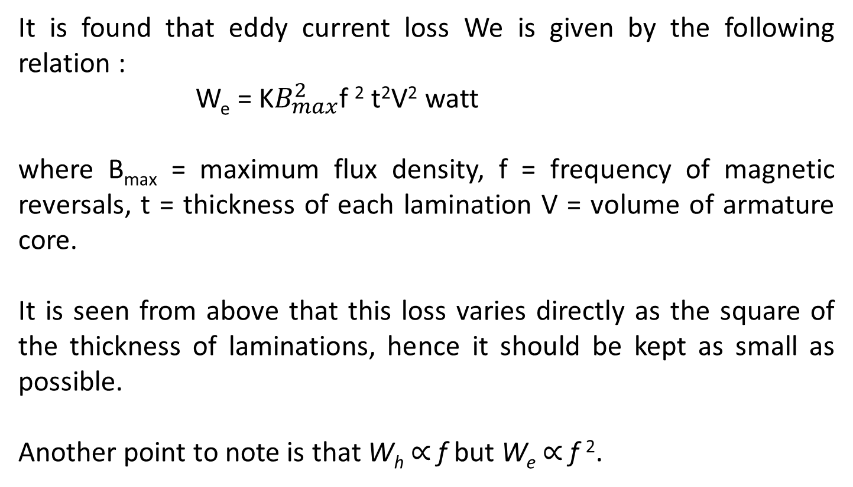
Eddy Current Loss
It is found that eddy current loss We is given by the following relation :
W_{e} = K$B_{max}^{2}$f ² t²V² watt
where B_{max} = maximum flux density, f = frequency of magnetic reversals, t = thickness of each lamination V = volume of armature core.
It is seen from above that this loss varies directly as the square of the thickness of laminations, hence it should be kept as small as possible.
Another point to note is that W_{h} ∝ f but W_{e} ∝ f ².

Slide 52
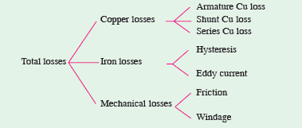
Total Loss in a D.C. Generator
The various losses occurring in a generator can be sub-divided as follows :
Copper Losses
Magnetic Losses
Mechanical Losses

Slide 53
Stray Losses
Usually, magnetic and mechanical losses are collectively known as Stray Losses.
These are also known as rotational losses for obvious reasons.

Slide 54
Constant or Standing Losses
As said above, field Cu loss is constant for shunt and compound generators. Hence, stray losses and shunt Cu loss are constant in their case. These losses are together known as standing or constant losses W_{C}.
Hence, for shunt and compound generators,
Armature Cu loss I_{a}²R_{a} is known as variable loss because it varies with the load current.
Total loss = variable loss + constant losses W_{C}

Slide 55
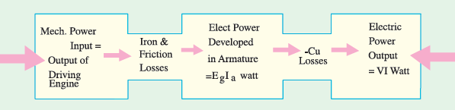
Power Stages
Various power stages in the case of a d.c. generator are shown below :
Following are the three generator efficiencies :
Mechanical Efficiency
Electrical Efficiency
Overall or Commercial Efficiency

Slide 56


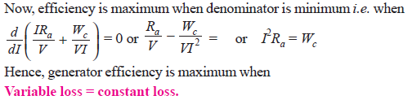
Condition for Maximum Efficiency
Generator output = VI
Generator input = output + losses

